Slide 1

ATHENS UNIVERSITY OF ECONOMICS & BUSINESS
DEPARTMENT OF MANAGEMENT, SCIENCE & TECHNOLOGY
MSc BUSINESS ANALYTICS
“Assignment for Course: Analytics Practicum II”
Full Name: STAMATIOS SIDERIS
Register Number: f2822113

Slide 2

Analysis of Airports’ on-time performance in the USA for years 2003-2004 with the use of Visualizations
in R

Slide 3
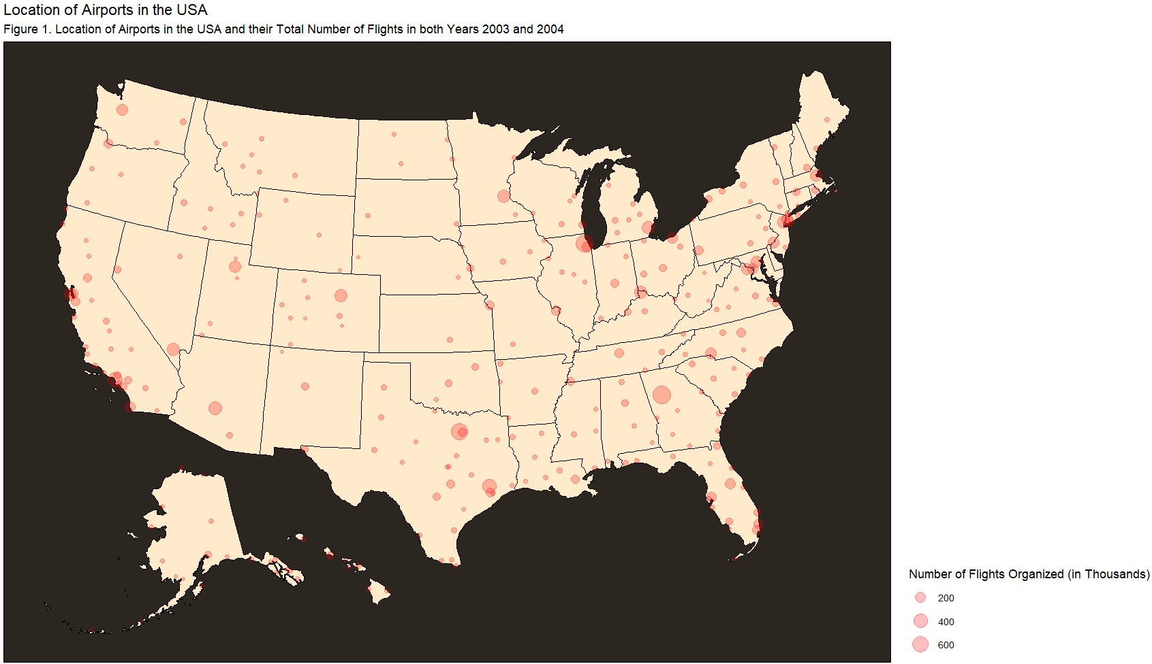
A great number of airports is spread across the USA. The majority is concentrated in the East States where, also, the airports with the highest number of organized flights in both years 2003 and 2004 could be found.

Slide 4
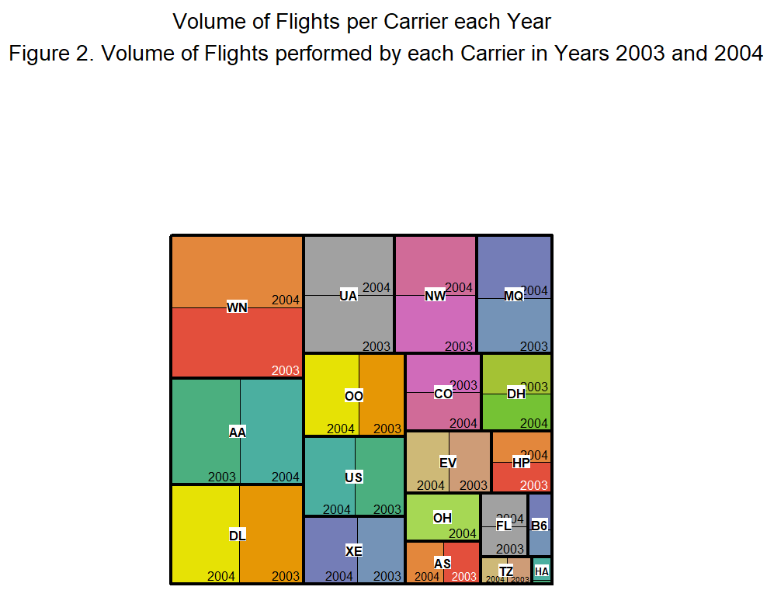
A total of 19 unique carriers organized flights in 2003 and 2004 and the number of flights organized seems balanced between both years and slightly in favor of year 2004.
PSA Airlines (code OH) performed flights only in 2004.

Slide 5
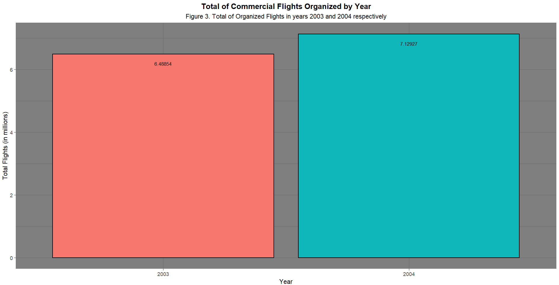
6.48 million and 7.12 million commercial flights were organized in 2003 and 2004 respectively. It is observed an increase of around 0.64 million in 2004.

Slide 6
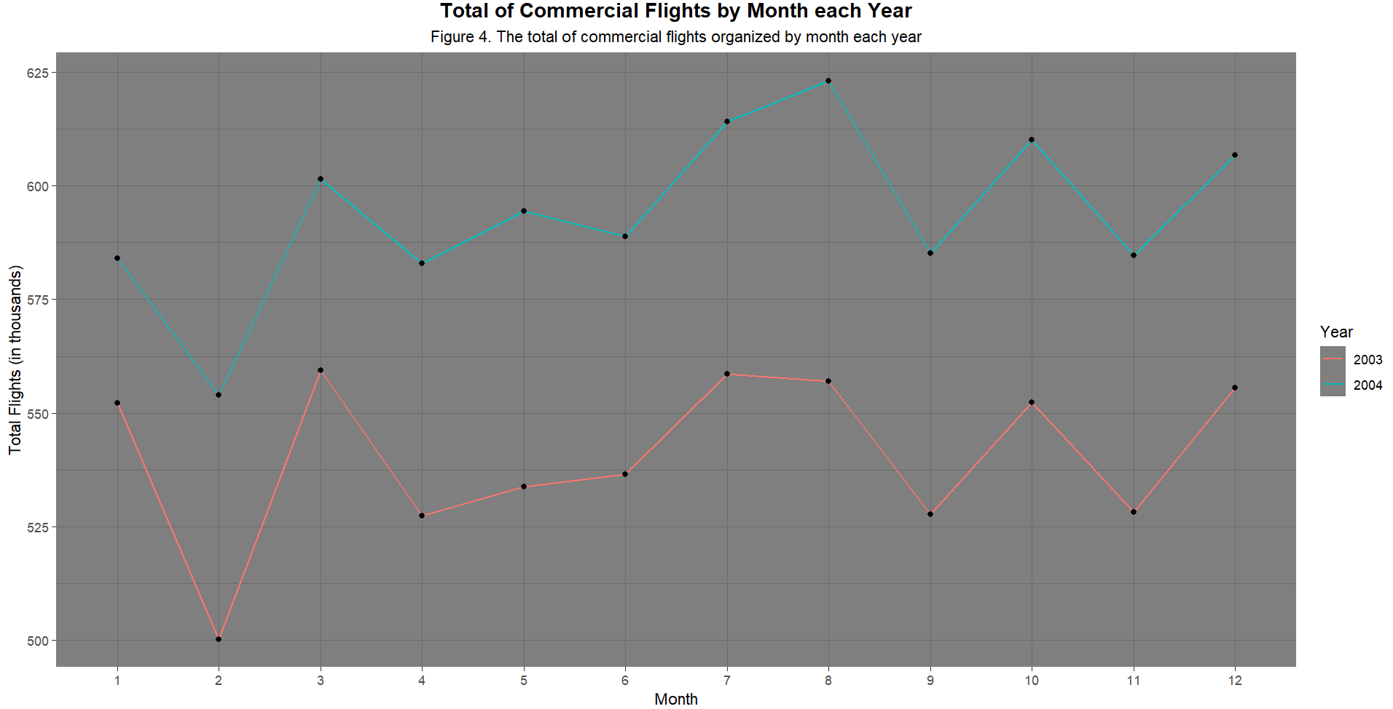
The commercial flights are increased for all months in 2004 compared to 2003. Differences in patterns are observed as year 2003 had an increase in flights in June compared to the decline in June of 2004 while year 2004 had an increase in flights in August compared to the decline in August of 2004.
Outstanding volume of flights is observed in August of 2004 compared to the rest of the year as well as compared to 2003.
February was a very low in volume month for both years.

Slide 7
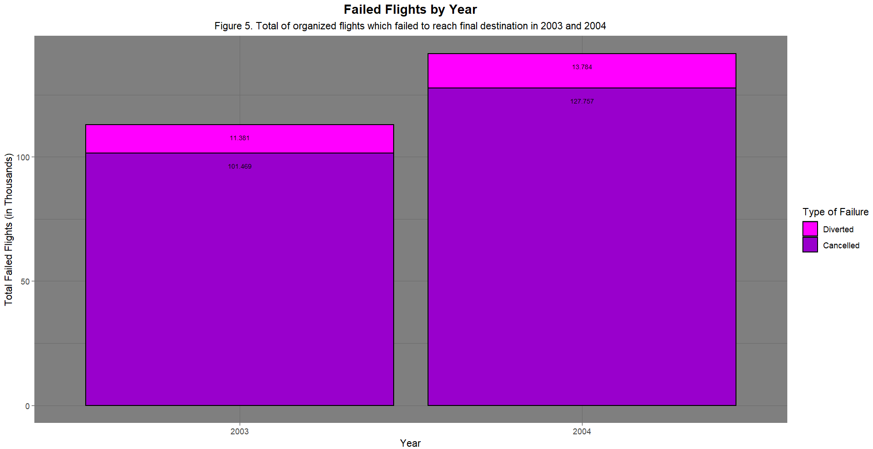
An increase of around 28 thousand in failed Flights is observed in 2004 in contrast to 2003, which is normal as more flights were organized in 2004.
The ratio between diverted and cancelled flights remains almost stable between 2003 and 2004.

Slide 8
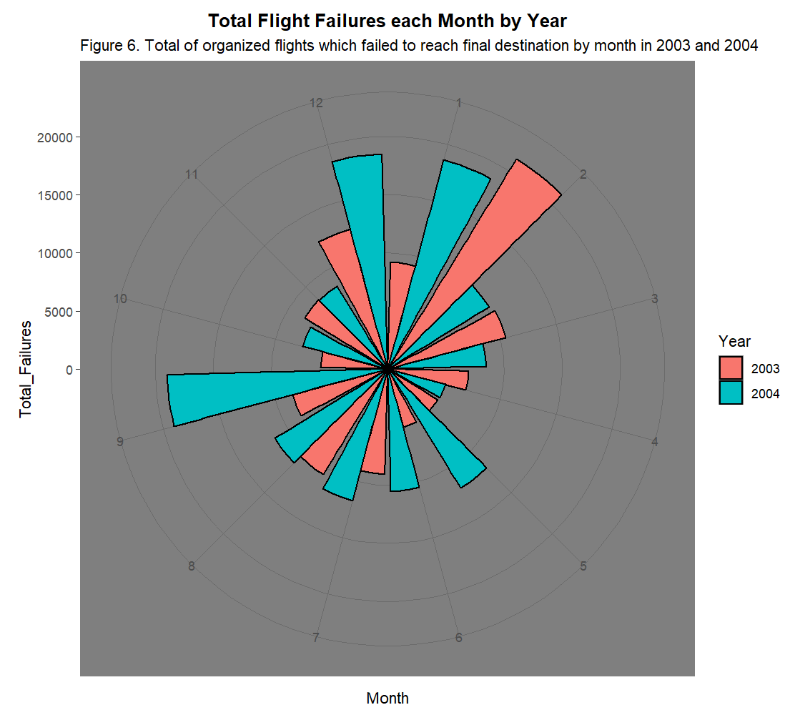
It is observed that abnormally high number of failures occur at the start of year 2003 while, abnormally high number of failures present at the start, in the end and in September of year 2004.
As known by Figure 4, January and December are months of average volume for both years while month September is a month of low volume for year 2004. Based on that, failures do not seem to be correlated to the weakness of airports to respond to them due to popularity of the months.

Slide 9
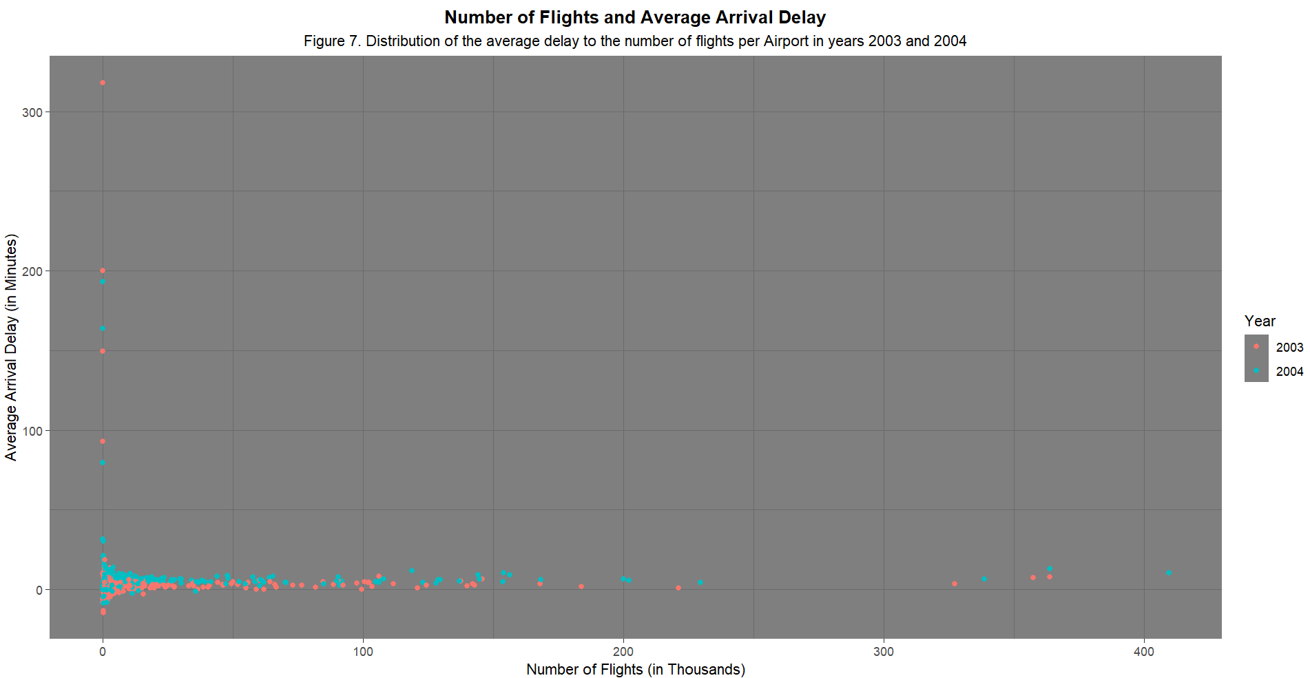
In Figure 7, it is observed that the most probable airports to present high average arrival delays are the ones with a lower number of completed flights each year.
The greatest amount of completed flights is performed in 2004 with over 400 thousand completed flights and an average delay of around 10 minutes per flight while the highest average delay by airport is observed in 2003 from an airport of very low number of flights and an average delay per flight of almost equal to 350 minutes.

Slide 10
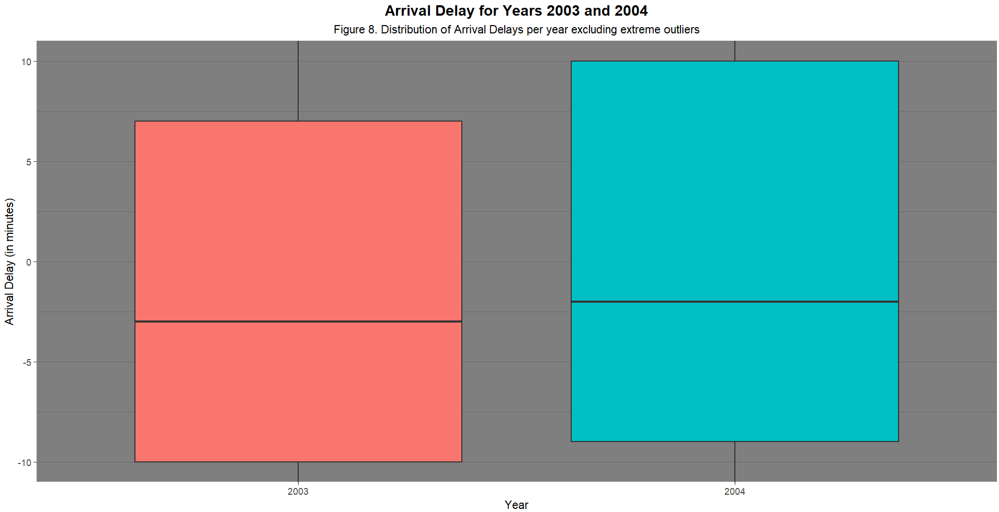
In Figure 8, we create a boxplot that excludes the extreme outliers and concentrates to its interquartile range.
Both years are keen to overperform against their forecasted arrival times as over 50% of the completed flights had arrival delay under zero.
50% of flights in 2003 had a delay in interval [-10,7] (in minutes) while 50% of flights in 2004 had a delay in interval [-9,10] (in minutes). Year 2003 seems to perform better on arrival times than year 2004 having proportionally more flights that outperformed the forecasted arrival time.

Slide 11
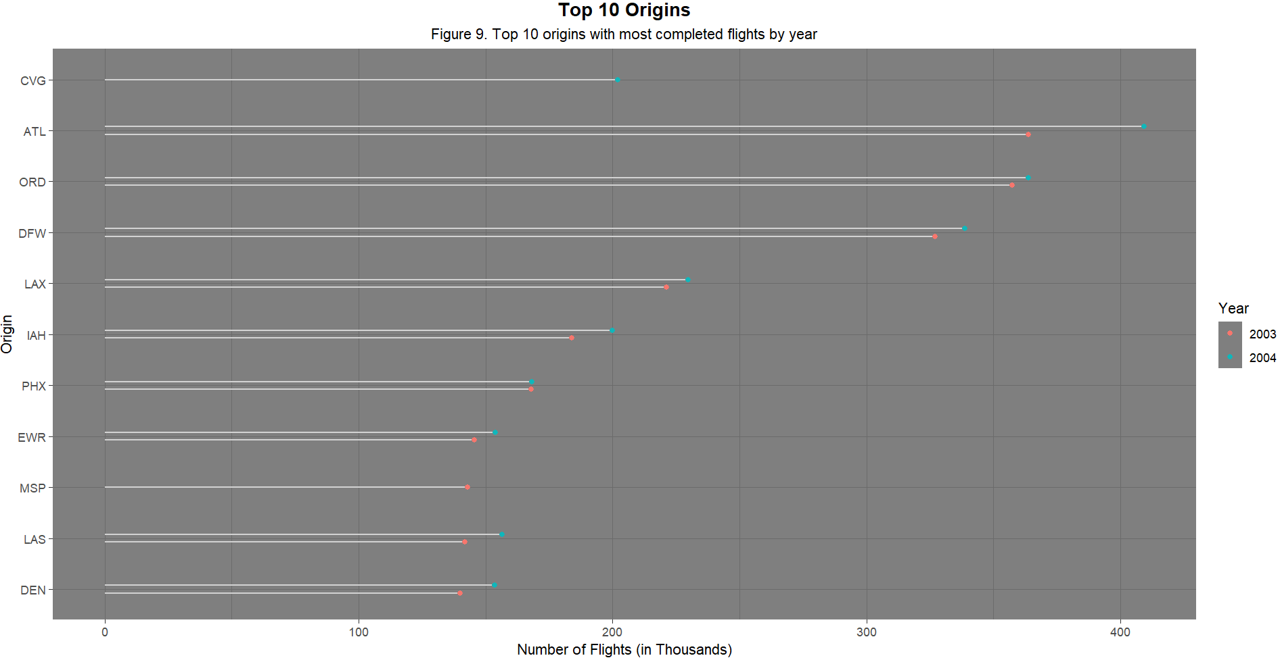
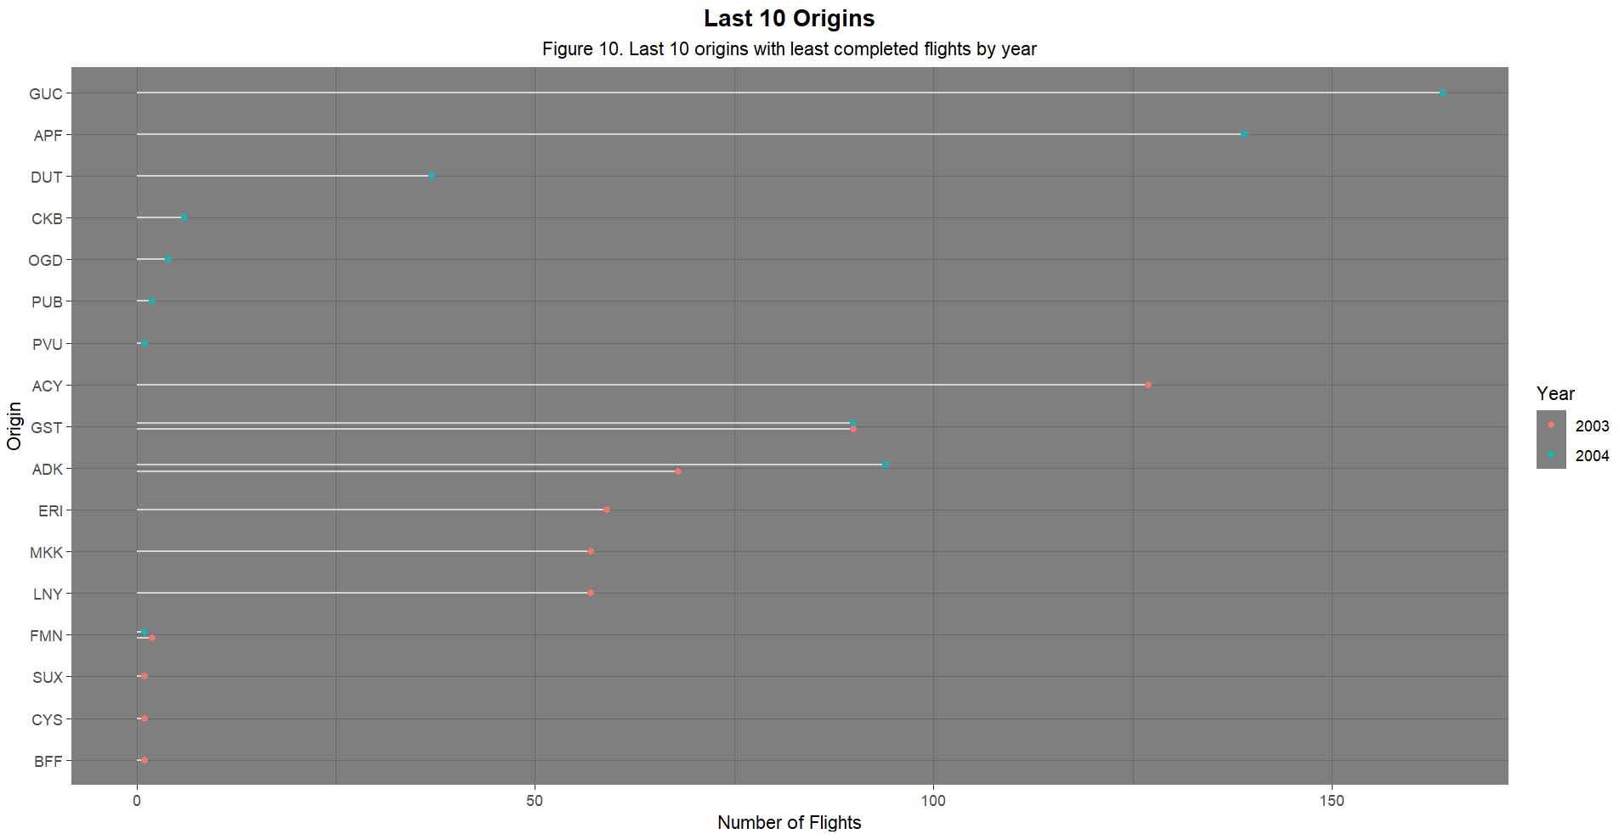
Almost all top-10 airports with most completed flights in 2003 remained in the top-10 in 2004.
Minneapolis-Saint Paul International Airport lost its position in 2004 by Cincinnati/Northern Kentucky International Airport.
The airport with most completed flights in both years is the Hartsfield-Jackson Atlanta International Airport.
Most of last 10 airports with least completed flights in 2003 lost their position in the list in 2004.
Some of these airports in 2003 are Sioux Gateway Airport, Cheyenne Regional Airport and Western Nebraska-Scottsbluff Regional Airport substituted by Four Corners Regional Airport, Provo Airport and Pueblo Memorial Airport in 2004 .

Slide 12
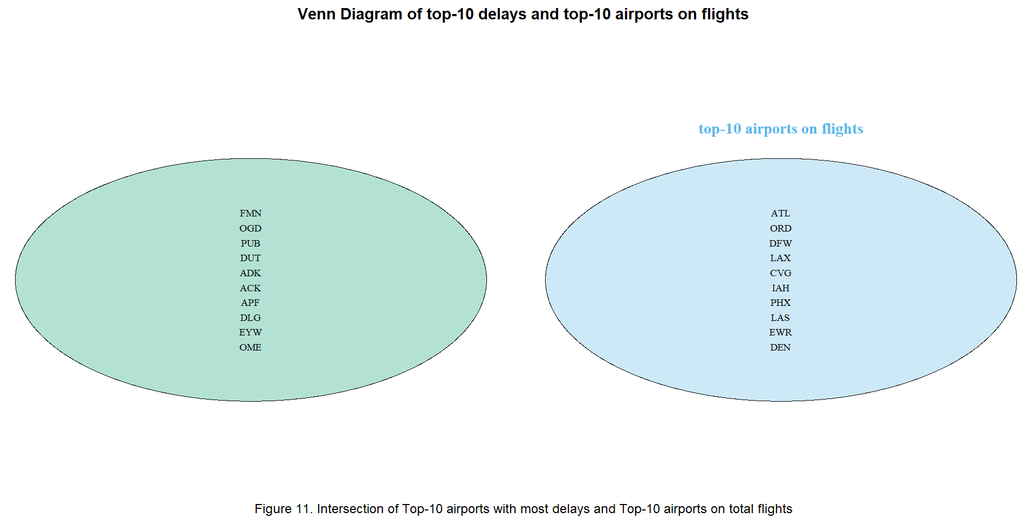
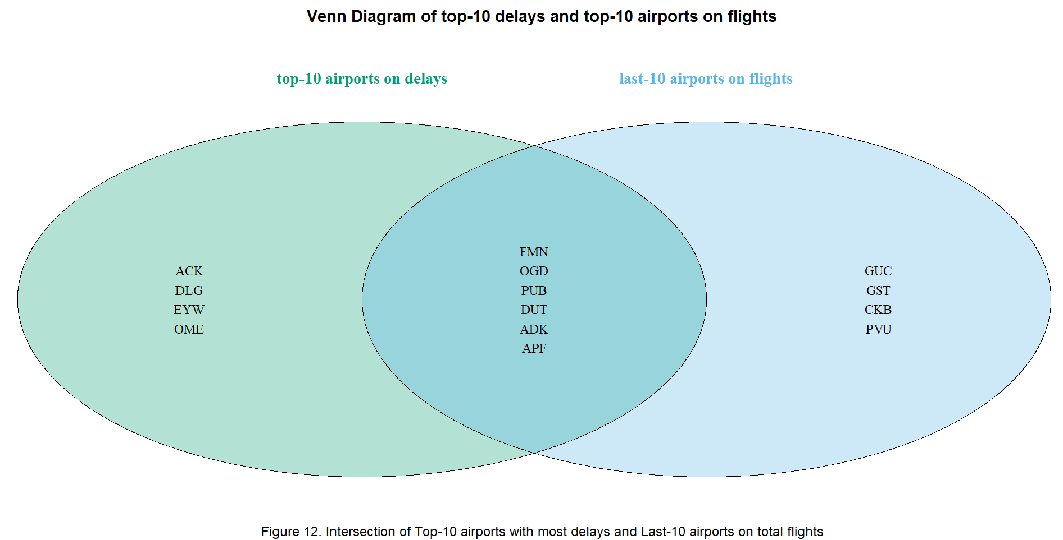
In Figure 11, it is observed that there is no intersection between airports with high delays and airports with great number of completed flights in 2004. Airports with high volume are not victims of extreme delays.
In Figure 12, it is observed that there are 6 airports that present high delays while completing a low number of flights in 2004. Small airports seem to be victims of extreme delays.
The airports in the intersection of Figure 10 are the worst performing airports of 2004.

Slide 13
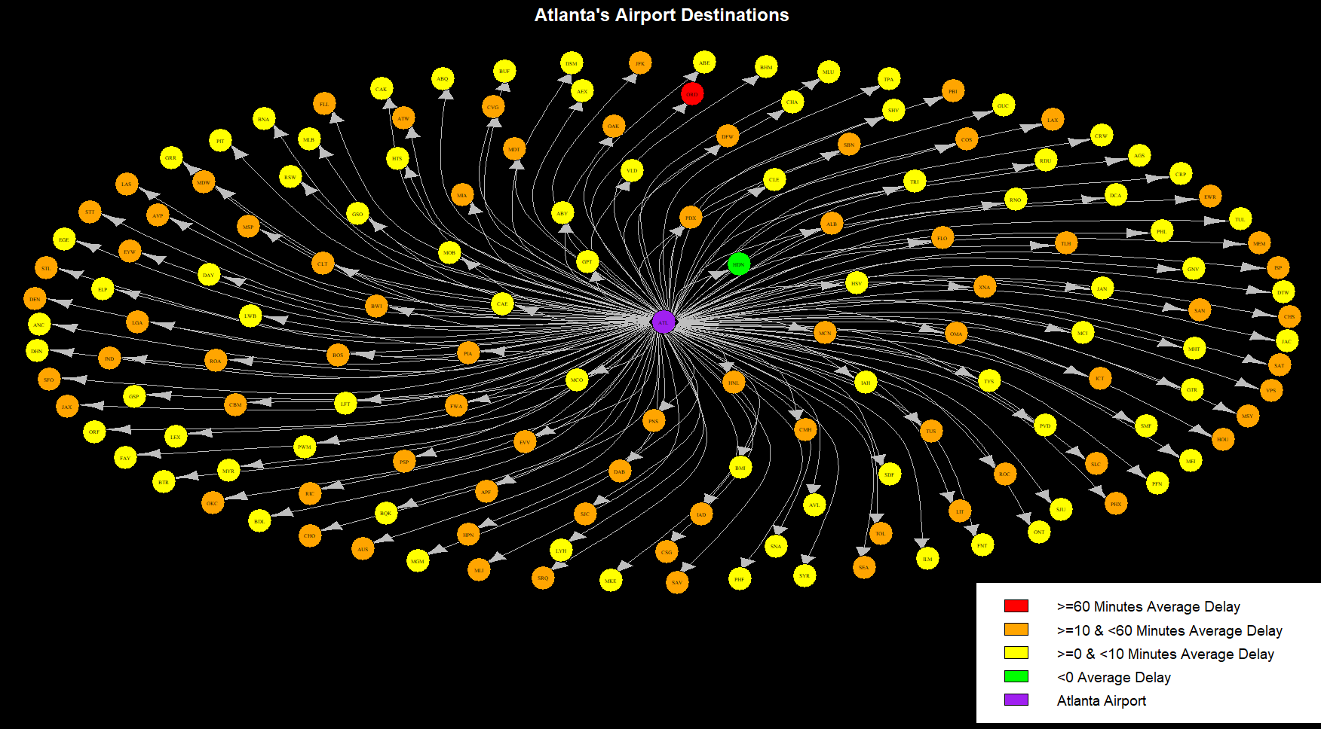
Analysis
In Figure 13, we represent the total of airports that the best performing airport, by number of completed flights, visited in 2004.
It is observed that flights with destination to O’Hare International Airport and Greenbrier Valley Airport present extreme arrival delays of over 60 minutes long.
Most of the other flights have an average arrival delay of 0-10 and 10-60 minutes.
Finally, flights with destination to Yampa Valley Airport outperform on average the forecasted arrival times.

Slide 14
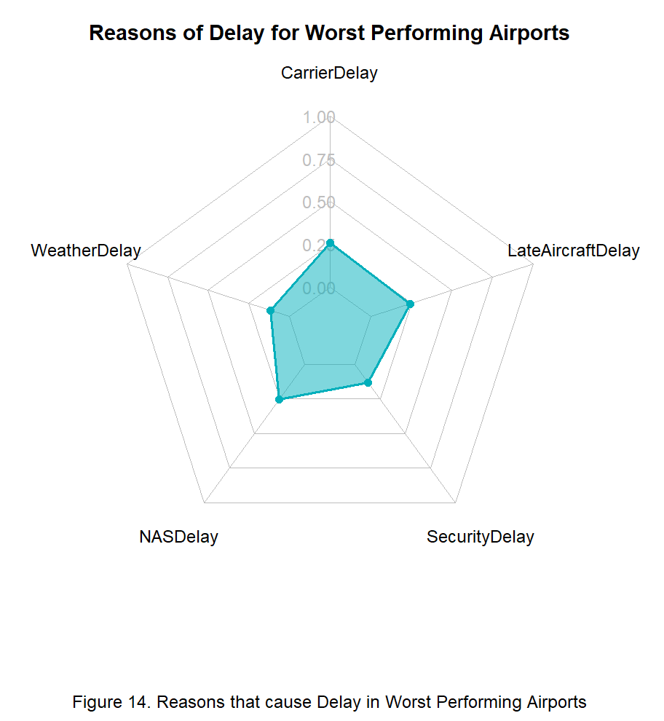
Analysis
In Figure 14, for the worst performing airports as observed in Figure 11, the most important reasons for delay was out of airports’ ability to avoid them.
The most important reasons was due to the late arrival of aircrafts at previous airports leading to the ripple effect called delay propagation and due to Carrier’s delay which is correlated to delays within the control of the air carrier such as aircraft cleaning, aircraft damage, awaiting the arrival of connecting passengers or crew, baggage, engineering inspection etc.

